Slide 1
Boundary Value Analysis
by -
Naveen kumar(61838)

Slide 2
contents
INTRODUCTION
WHAT IS BOUNDARY VALUE?
WHY TEST THE BOUNDARIES?
VALID / INVALID VALUES
REPRESENTATION
LIMITATIONS OF BVA
APPLICATIONS

Slide 3
INTRODUCTION
• Boundary value analysis (BVA) is a black-box test design technique in which test cases are designed based on boundary values
• Conceptually, boundary value analysis is about testing the edges of equivalence classes

Slide 4
What is a Boundary Value?
• An input value or output value that is on the edge of an equivalence partition.
• At the smallest incremental distance on either side of an edge.
E.g., the minimum or maximum value of a range
• The point where the expected behavior of the system changes.
• The values could be either input or output ranges of a software component

Slide 5
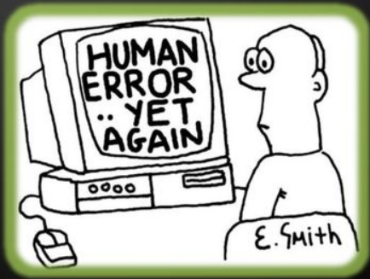
Why Test the Boundaries?
• If an operation is performed on a range of numbers:
• Odds are the programmer got it right for the vast majority of the numbers in the middle.
• But maybe made a mistake at the edges

Slide 6
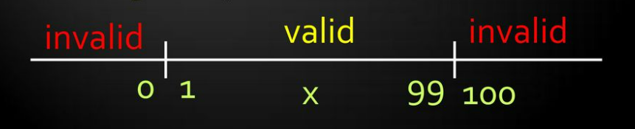
Valid / Invalid Values
• If the boundary values are members of a valid equivalence class, they are valid.
• If they are members of an invalid equivalence class, they are invalid.
• Not all equivalence classes have boundary values!.
• Boundary value analysis is an extension of equivalence partitioning

Slide 7
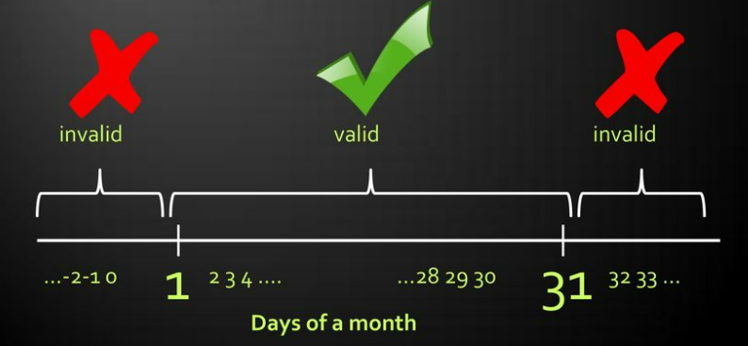
VALID / INVALID VALUES

Slide 8
REPRESENTATION
• The boundary lies between the largest member of one equivalence class and the smallest member of the equivalence class above it.
• The boundary itself doesn't correspond to any member of any class .
• Only two boundary values are considered at each edge of a partition class

Slide 9
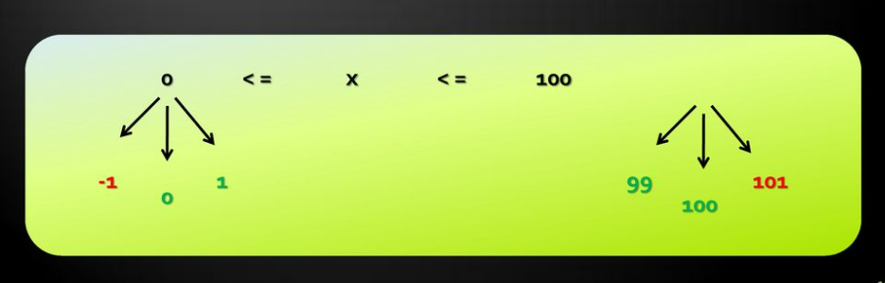
REPRESENTATION
• The mathematical analysis sets three values at each edge:
• The value corresponding to the boundary itself;
• The closest value inside the partition;
• The closest value outside the partition.

Slide 10
Limitations of BVA
• Boolean and logical variables present a problem for Boundary Value Analysis.
•because Boolean is a datatype which has only values as 1 and 0.
• It can’t test the all test cases values.

Slide 11
Applications
Used to test software programs.
Used to test in embedded applications etc.,

Slide 12
Thank you …..!!!

